Slide 1
Object Oriented Programming Part 6: Data Encapsulation
By: Ryan Alterman
Revised: 10-25-17

Slide 2
What is Data Encapsulation?
All programs have two parts:
Program Statements( code)
Functions
Program Data
The manipulated data( variables)
Combines the data and functions to manipulate data
Another way to hide things from users to protect the program
This is a method for BUNDLING data
Abstraction is the process of exposing the interface and hiding the implementation
TWO COMPLETELY DIFFERENT THINGS!
This is done by the use of classes
Access labels are a form of encapsulation
Making a class the friend of another reduces encapsulation
Goal is to keep things as hidden as possible

Slide 3
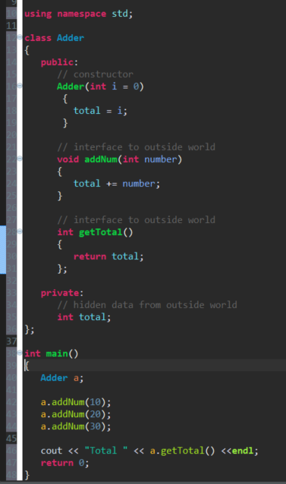
Example of Data Encapsulation and Data Abstraction

Slide 4
Application of Designing Code
Making things Public, Private, and Protected is just good practice
Encapsulation Applies to:
Data Members
And other members
Virtual Functions
Etc.

Slide 5
Challenge
When have we used encapsulation before this(if at all)? Why would we use this? How does this apply to our team? Please discuss.

Slide 6
Next: Object Oriented Programming Part 7( The final one)

